Slide 1


Aims of the course:
Part 1: To define oral communication
Part 2: To examine some research and principles
Developing spontaneous speech
Part 3: To explore the obstacles to spontaneity and develop some solutions
Part 4: To get practical ideas that you can use as of tomorrow
Part 5: To start planning for implementation

Slide 2
PART1: What is Oral Communication?

Slide 3

PART1:
How do we communicate meaning when speaking?
Make a list
………………………………………………………………..
………………………………………………………………..
………………………………………………………………..
………………………………………………………………..
………………………………………………………………..
………………………………………………………………..

Slide 4
Ideas
Information
Arguments
Structure
Introduction
Transitions
Language
Accuracy, grammar
Opinions
Expression of feeling
Logical sequences
Examples
Conclusion
Vocabulary
Social conventions
Register
Content
Speaking
Non-verbal
Gestures
Facial expressions
Rhythm
Pauses
Silences
voice
Volume
Pronunciation, accent
body language
Flow
Intonation
Nature
Source: Nathalie PORTE 2016- www.nathaliefle.com

Slide 5

Can you come up with your own
definition of quality oral communication?
Developing spontaneous speech
“For me, quality oral communication is…”
Share your definition and discuss.

Slide 6
Aims of the course:
Part 1: To define oral communication
Part 2: To examine some research and principles
Developing spontaneous speech
Part 3: To explore the obstacles to spontaneity and develop some solutions
Part 4: To get practical ideas that you can use as of tomorrow
Part 5: To start planning for implementation

Slide 7
PART2: Research and Principles

Slide 8



So…, how do we learn to speak?
How do you learn language?
Babies listen to people talking from the time they are born, and so they are learning language from the very beginning. Adults tend to use exaggerated 'baby-talk', stressing particular parts of speech and attracting the baby's attention. From the age of six months babies begin to concentrate on their own language. They stop babbling by nine months or so and later learn single words, two-word speech, and whole sentences around the age of three. By the age of 18, you may have learnt around 60,000 different words.
Listening to adults helps babies to learn their own language.
Source: www.sciencemuseum.org.uk

Slide 9
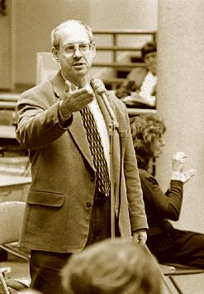

Stephen Krashen
American linguist, educational researcher, and political activist
In the 80’s he developed his Theory of Second Language Acquisition
Watch the video (15 minutes) then share your reactions.
Access Stephen Krashen’s video following this link:
https://www.youtube.com/watch?v=NiTsduRreug

Slide 10
Stephen Krashen: The theory of second language acquisition
Share your reactions, comments or thoughts (you are allowed to disagree ☺)
The 5 hypothesis:
Acquisition is an unconscious and informal process that involves “picking up” language through real meaningful activities and interactions. Learning is a conscious formal process (grammar, knowing about the language). Acquisition is more important.
1. the Acquisition vs Learning
2. the Monitor
3. the Natural Order
4. the Input
5. the Affective Filter hypothesis
The learner acts as a monitor, using learning to self-correct his acquisition (redraft, correct, edit).
The acquisition of grammatical structures follows a natural order that is predictable and mimics the acquisition of the first language. Grammar should also be taught in the target language.
the learner improves and progresses along the 'natural order' when he/she receives second language ‘comprehensible input' that is one step beyond his/her current stage of linguistic competence.
Low motivation, low self-esteem, and anxiety can combine to 'raise' the affective filter and form a 'mental block' that prevents comprehensible input from being used for acquisition.

Slide 11

Johan Tekfak, creator of the method “français authentique”
Creator of the French learning method “français authentique”
Method created in 2011
Claims his method has helped almost 60,000 by 2016
(www. francaisauthentique.com)

Slide 12
Johan Tekfak
Any reactions, comments or thoughts?
(www. francaisauthentique.com)
key rules:
1. Listen and understand
2. Repetition
3. No stress
4. Listen to stories
5. Use the context
6. Learn through real TL
No vocabulary list or grammar. Listening actively to as much authentic Target Language as possible on condition that you understand some of it. The brains will make links.
Listening and repeating language content that you understand.
No fear about making mistakes, take time, no pressure about achievement.
Listen to stories, real life situations containing key words/phrases.
Use the context of a given situation (where? When? Weather? Who?...) to form a mental picture and deduce meaning.
Use authentic material spoken by native speakers.

Slide 13
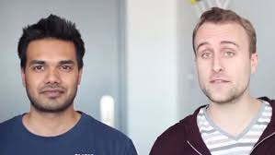
Scott Young & Vat Jaiswal
2 young Americans who decided to spend a year travelling to Spain, Brazil, China and Korea.
During that year they managed to learn to speak Spanish, Portuguese, Chinese and Korean fluently.
How?

Slide 14
Scott Young & Vat Jaiswal
1 rule:
Don’t speak ENGLISH!
Use reference material to communicate if necessary but use 0% English to communicate.
Communicate as much as possible with native speakers in the Target Language.
Make mistakes.
Reactions, comments or thoughts?

Slide 15
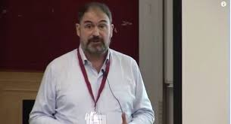
Chris Lonsdale
Psychologist, linguist and educator from New Zealand.
In 1984, Lonsdale moved to Hong Kong, where he learned Cantonese Chinese.
His book, The Third Ear, is based on his personal experience of learning foreign languages and his training in psychology.
Watch the video (3 minutes), then share your reactions.
Access Chris Lonsdale ’s video following this link:
https://www.youtube.com/watch?v=JMcvKWppPpM

Slide 16
Chris Lonsdale
Reactions, comments or thoughts?
5 Principles:
Focus on language content that is relevant
Use TL to communicate from day 1
When you understand you unconsciously acquire the language
Physiological training
Psycho-physiological state matters
7 actions:
Listen a lot
Get the meaning first
Start mixing language components
Focus on core language
Toolbox: useful phrases in the TL
Language parent
Copy the face
Language parent
Works to understand what the learner says
Does not correct mistakes
Confirms understanding by using correct language
Uses words the learner knows

Slide 17

Summary of key findings
Repetition
The use of Target Language
Target Language to be used 100% to communicate
Listening & comprehensible input
A lot of it and must have meaning
Core language
Relevant content
Interesting and has a purpose/relevance
Use of authentic material
Realia, native speakers, video? TV?...
Toolbox
Useful key language to find out about the language and progress
Stories
Mistakes
Should happen and should not be corrected
Grammar
Used to verify and self-check- Not just for the sake of learning
Low anxiety and pressure to achieve but high self-esteem
and motivation are necessary.
Mixing language
Stress
Language nature
Non-verbal communication, voice, rhythm, intonation matter

Slide 18
Final discussion for this part:
Which language acquisition strategy from the principles explored today are you going to consider including in your teaching?
Are you skeptical about any concepts shared with you in this part?
Developing spontaneous speech

Slide 19
Aims of the course:
Part 1: To define oral communication
Part 2: To examine some research and principles
Developing spontaneous speech
Part 3: To explore the obstacles to spontaneity and develop some solutions
Part 4: To get practical ideas that you can use as of tomorrow
Part 5: To start planning for implementation

Slide 20
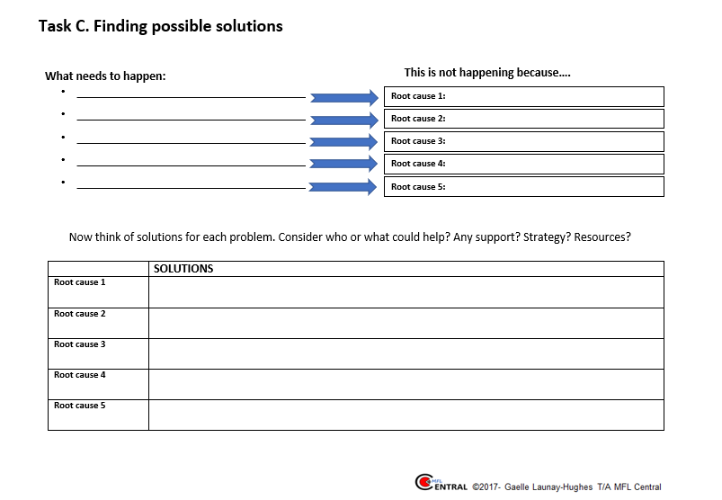
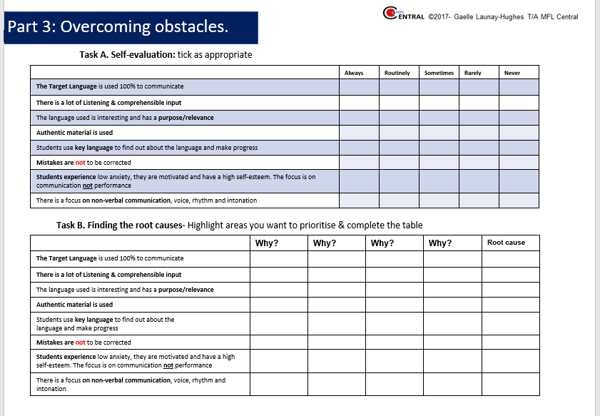
PART 3: Exploring the Obstacles to Spontaneity and Develop Solutions
FOR THIS YOU WILL NEED THE HANDOUT

Slide 21


PART3: Overcoming obstacles
So, why won’t they speak spontaneously?!
Access the video (3 minutes) following this link:
https://www.youtube.com/watch?v=zV1zK8zRCPo
✗

Slide 22

Previously in this course, we have established that the following principles supported spoken language acquisition :
The Target Language is used 100% to communicate
There is a lot of listening & comprehensible input
The language used is interesting and has a purpose/relevance
Authentic material is used
Students use key language to find out about the language and make progress
Mistakes are not to be corrected
Students experience low anxiety; they are motivated and have a high self-esteem. The focus is on communication not performance
There is a focus on non-verbal communication, voice, rhythm and intonation
✓
✓
✓
✓
✓
✓
✓
✓

Slide 23
Self-evaluation: how would best describe your current practice?
 | Always | Routinely | Sometimes | Rarely | Never
The Target Language is used 100% to communicate
There is a lot of Listening & comprehensible input
The language used is interesting and has a purpose/relevance
Authentic material is used
Students use key language to find out about the language and make progress
Mistakes are not to be corrected
Students experience low anxiety; they are motivated and have a high self-esteem. The focus is on communication not performance
There is a focus on non-verbal communication, voice, rhythm and intonation
Complete task A of your handout

Slide 24

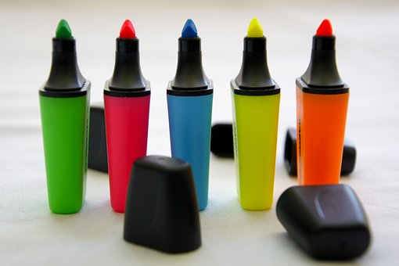

Is there one (or more) area for which you ticked rarely or never?
This area should be your priority (unless you wish to explore other principles?)
Highlight at least one priority in the table (task B of your handout)

Slide 25

Highlight the areas you have prioritised
Causes should be within your control
This is not happening or not enough | Why? | Why? | Why? | Why? | Why?
The Target Language is used 100% to communicate
There is a lot of Listening & comprehensible input
The language used is interesting and has a purpose/relevance
Authentic material is used Example: | We use text books | Easier to plan | Not enough authentic material | No sharing of resources | No resource bank in place
Students use key language to find out about the language and make progress
Mistakes are not be corrected
Students experience low anxiety, they are motivated and have a high self-esteem. The focus is on communication not performance
There is a focus on non-verbal communication, voice, rhythm and intonation
Root cause

Slide 26
What needs to happen:
_____________________________________
_____________________________________
_____________________________________
_____________________________________
_____________________________________
What hinders development (root cause)
Discuss and write down possible solutions

Slide 27
Aims of the course:
Part 1: To define oral communication
Part 2: To examine some research and principles
Developing spontaneous speech
Part 3: To explore the obstacles to spontaneity and develop some solutions
Part 4: To get practical ideas that you can use as of tomorrow
Part 5: To start planning for implementation

Slide 28
PART 4: Practical Ideas That You Can Use as of Tomorrow.

Slide 29
PART 4: In practice
The longer you wait, the more difficult it gets.
Maximising the use of TL
From lesson 1 –Teacher’s use of TL
Students’ use of the TL
The more TL is
used, the easier it gets.
Simple instructions/ expressions supported by non-verbal clues.
Classroom routine.
Use of cognates.
Writing words on the board.
Visual supports/ pictures
Grammar? Classroom management?
‘Toolbox’ (E.g., displays, speaking mats…)
The ‘dumb teacher’. Insist on TL use for classroom. communication.
Use reward.
Create opportunities for peer-to-peer communication in the TL.
Do not beat yourself up!

Slide 30
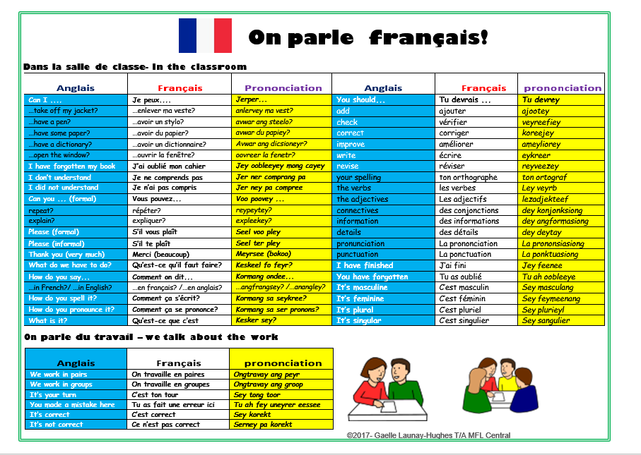
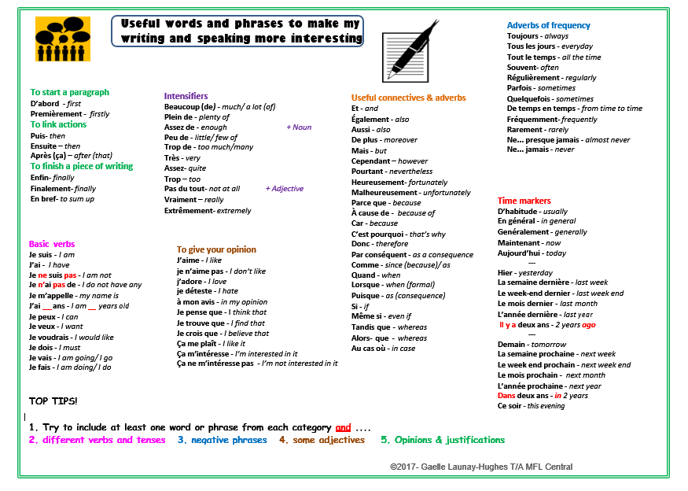
Some practical suggestions
Hand out one mat per pupil at the start of the lesson. (Hand them out for your first class and leave them on the desk until the end of the day?)
Speaking mat: classroom communication with the teacher
One side of the mat comprises a list of classroom instructions with their meaning and phonetic transcription, the other side is a list of useful words
and phrases pupils may want to use when speaking
and writing.
Insist for classroom communication to take place in the target language. If pupils make a request, they must do so in the target language. The teacher must play the part of ‘the dumb teacher’ who only understands target language. Any request in English must be rejected and pupils encouraged to use their mat.
Pupils may be a little frustrated initially but with time and perseverance pupils get less dependent on their mat and begin to enjoy using the target language for a real communicative purpose.

Slide 31
Some practical suggestions
The classroom instructions list includes structures to discuss their work. The MFL Framework requires that pupils talk about their work in the target language. This seems quite a challenge but can be achieve at a basic level initially.
The speaking mats can be used for simple peer assessment. Following a completed task ask pupils to work in pairs and to give one comment in the target language to their partner.
By establishing this as a routine pupils progressively become more confident and even end up asking for additional vocabulary that enables them to formulate more complex feedback.
Speaking mat: classroom communication with peers
Be patient and have fun!

Slide 32
Some practical suggestions
La pyramide 1: Developing confidence
Practise each ‘level’ of the pyramid individually and encourage pupils to come up with a range of language.
sujet (je, tu..)
je
Je veux
+ opinion ou modal
Je veux manger
+ verbe (infinitif)
Je veux manger des frites
+ complément
Je veux manger des frites au Mc Do
+ détail (où? Quand? Avec qui?etc)
Je veux manger des frites au Mc Do parce que c’est délicieux
+ justification

Slide 33
Some practical suggestions
La pyramide 2: Developing confidence
Progressively remove the support
je
sujet (je, tu..)
Je veux
+ opinion ou modal
Je veux manger
+ verbe (infinitif)
Je veux manger des frites
+ complément
Je veux manger des frites au Mc Do
+ détail (où? Quand? Avec qui?etc)
Je veux manger des frites au Mc Do parce que c’est délicieux
+ justification

Slide 34


Some practical suggestions
Débat démocratique A:
encouraging natural responses
L’anglais n’est pas autorisé!
Ecoutez l’affirmation
This activity can be done at the end of a topic (but doesn’t have to be)
Come up with a statement and pronounce it in the target language. A little controversy works best (E.g. “Les filles sont plus intelligentes que les garçons.”) as it triggers more reactions.
When saying the statement use any cues to ensure pupils can infer the meaning. Give them 1 minute to discuss and come up with the translation.


Oui | Non
Je suis d’accord Je pense que c’est vrai A mon avis c’est la vérité on peut dire ça Je trouve ça juste | Je ne suis pas d’accord Je pense que c’est faux A mon avis c’est un mensonge On ne peut pas dire ça Je ne trouve pas ça juste
Je pense que c’est ….. Je pense que ce n’est pas…
parce que…
Comment on dit ............? [ komangondee]
How do you say.................?

Slide 35
Some practical suggestions
Débat démocratique B :
encouraging natural responses
L’anglais n’est pas autorisé!
Ecoutez l’affirmation


Oui | Non
Je suis d’accord Je pense que c’est vrai A mon avis c’est la vérité on peut dire ça Je trouve ça juste | Je ne suis pas d’accord Je pense que c’est faux A mon avis c’est un mensonge On ne peut pas dire ça Je ne trouve pas ça juste
Je pense que c’est ….. Je pense que ce n’est pas…
Pupils then need to say if they agree or disagree but must justify their opinion.
Record the for and against answers. You can decide to give the class a certain amount of time after which ‘the vote’ will be closed or establish a number of responses allowed.
The side with the most answers wins the vote.
parce que…
Comment on dit ............? [ komangondee]
How do you say.................?

Slide 36

Some practical suggestions
Short plays and sketches: Developing confidence and fluency
Why use plays and sketches?
Pupils want their performance to be accurate. By performing a pre-written script, they do not have to worry about accuracy and can focus on their acting.
Before getting pupils to perform it is important to use the play/sketch as an opportunity to access and understand language out of a specific context. Pupils need to understand the situations, the plot and the effects contained in the script to be able to perform convincingly. Plays and sketches can, therefore, be used as reading activities in line with the New Framework.
All pupils have the same script; the audience (the other pupils) should not have any problems with comprehension.
Pupils are encouraged to memorise longer responses; by doing so they develop retention and recall strategies. They also gain in confidence by being able to express themselves accurately. Get pupils to learn their part for homework; this will give them more time to practise.

Slide 37
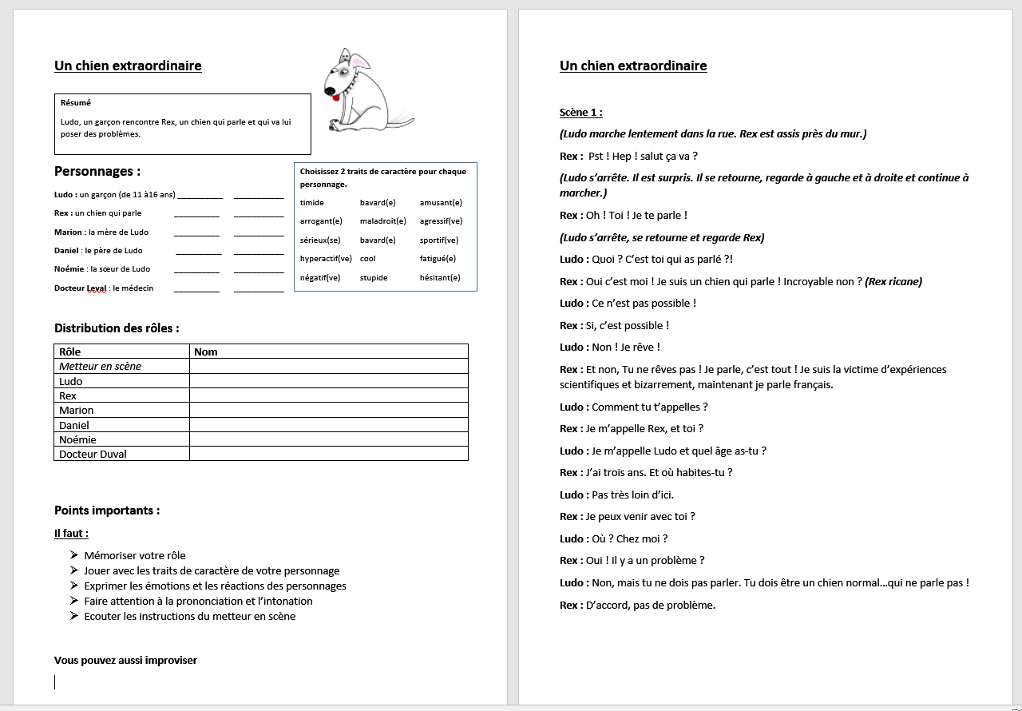
Some practical suggestions
Short plays and sketches: Developing confidence and fluency

Slide 38
Some practical suggestions
Talking images: Developing confidence and fluency
How does it work?
Quite simply:
show pupils an image (this can be linked to a topic but really doesn’t need to be)
get them to talk about the image. There is no rule about the information they need to provide; it can be factual and descriptive or contain opinions, assumptions or predictions, etc. It can be simple or complex, it does not matter. The aim is to participate!
No English allowed. The only ‘Joker’ is the phrase “comment on dit ? / ¿comó se dice?/ Wie sagt man?” that allows pupils to ask for specific words to the teacher so that they are able to give a complete answer and at the same time to learn new vocabulary items.
The role of the teacher is mainly to correct pronunciation and provide vocabulary to ‘fill in the gaps.

Slide 39



Parlez...
Some practical suggestions
Commentez cette image.
Où?
Qui?
Quoi?
Pourquoi?
Opinions?
Emotions?
Descriptions?
L’anglais n’est pas autorisé.
Talking images: Developing confidence and fluency
Comment on dit ............? [ komangondee]
How do you say.................?

Slide 40

Parlez...
Some practical suggestions
Commentez cette image.
Talking images: Developing confidence and fluency
Où?
Qui?
Quoi?
Pourquoi?
Opinions?
Emotions?
Descriptions?
Comment on dit ............? [ komangondee]
How do you say.................?

Slide 41

Parlez...
Some practical suggestions
Commentez cette image.
Talking images: Developing confidence and fluency
Où?
Qui?
Quoi?
Pourquoi?
Opinions?
Emotions?
Descriptions?
Comment on dit ............? [ komangondee]
How do you say.................?

Slide 42
Some practical suggestions
Talking images: Developing confidence and fluency
“But pupils will not want to participate!”
That’s why initially I established a few ground rules:
Everyone must speak at least once during the lesson. You will need to tick off names from your register (a bit time consuming initially but you get better at it). No one leaves before everyone has spoken (particularly effective before a break, lunch or the end of the day). That’s for the nasty bit!
Reward: after that, every additional intervention from pupils is recorded. Then you can give a mark equivalent to the number of contributions, give a reward after a certain number of contributions during the same lesson or over a definite amount of time. It is up to you (and your school policy) to decide what would be the most appropriate reward. However, it’s essential that good participation is rewarded.
Finally…
At first your pupils may feel a little self-conscious. This strategy requires a little perseverance but can see amazing results even from ‘the quiet ones’ and even spontaneous discussions between pupils who happened to disagree with one another in the TL. Result! Remember though that it is necessary to allow enough time within a lesson for pupils to express themselves without too much pressure.

Slide 43
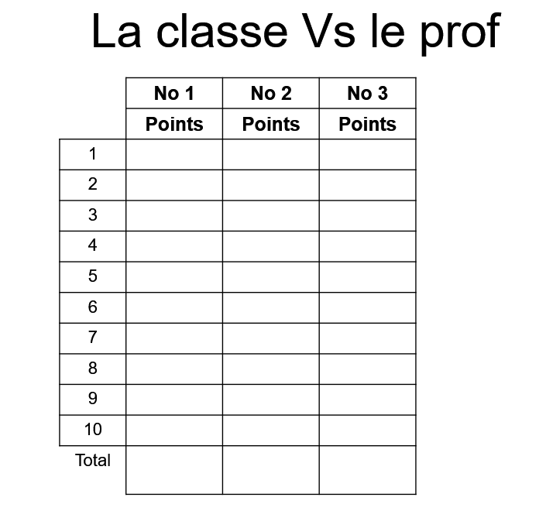
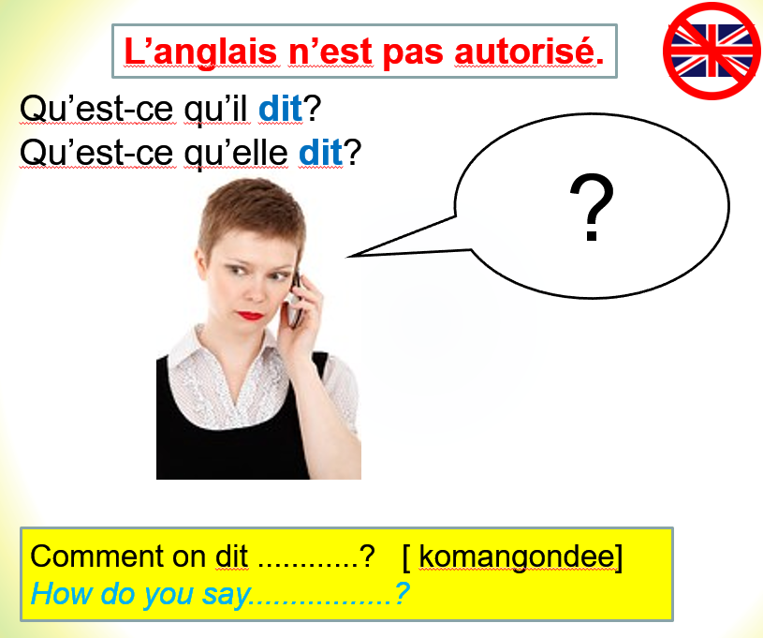
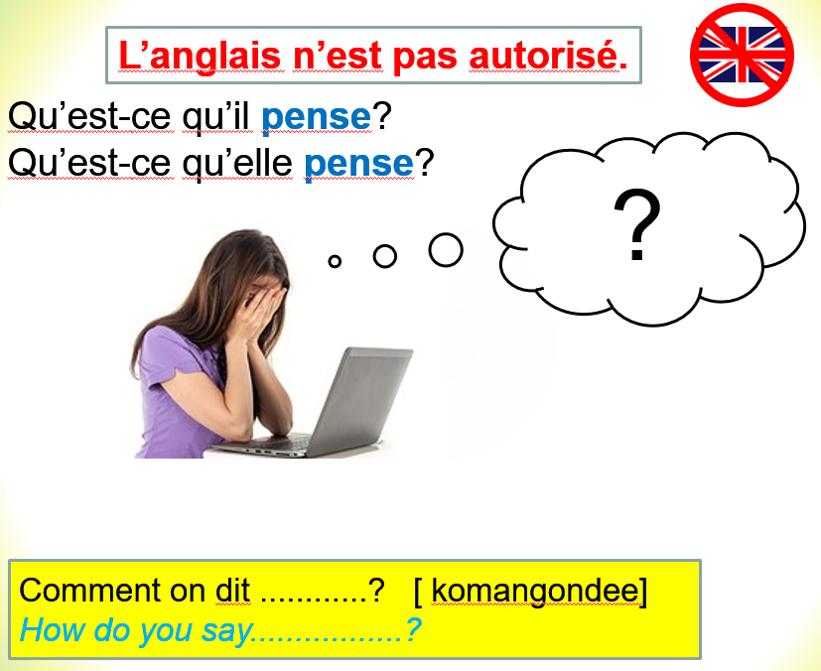
Some practical suggestions
La bulle: Developing confidence and fluency

Slide 44
Some practical suggestions
La bulle: Developing confidence and fluency
Images can be as varied as you may want. They can be linked to specific topics and/ or used as a general practice.
Pupils will be encouraged to use the first person.
You can give pupils a little thinking time to prepare or expect a totally spontaneous answer.
You can also require a certain structure or linguistic feature for the response to be validated.
Spice it up by turning it into a game: E.g., “la classe Vs le prof ”
- 1 point per contribution even short
- 2 points for the use of complex structures
- 3 points for the use of several complex structures
- 1 round = 10 contributions
- The class must have reached 20 points to win the round, if not, the teacher wins. You may decide to increase or decrease the number of points to win the round and change the criteria for the number of points awarded per contribution.
- Depending on the time you have play one round, best of 3 or 5 round
- An extra 5 points can be awarded to the class if every pupil in the class has made at least one contribution.

Slide 45
Some practical suggestions
La partie de football: Developing confidence and fluency
Decide on which team will go first.
Starting from the centre of the pitch, 1 player from the starting team gives a response. Each correct response enables team players to move the football along the pitch, one strip of the pitch at a time until they reach the goal and score. (4 correct responses are therefore needed for a goal.)
When an incorrect response is given, the other team gets the hand and follows the same process, in the opposite direction towards their own goal post.
After a goal has been scored by one of the teams, the game starts again from the centre of the pitch. The team with the most goals wins.
Specify the type of contribution you want (e.g. answer the questions)
You can award more than one move depending on the quality/ complexity of the response.

Slide 46
Some practical suggestions
Intonation : Being sensitive to the spoken word
1. Read each sentence aloud insisting on the intonation.
Tu pars demain. → No particular inflexion on the word demain = affirmation
Tu pars demain? → demain is pronounced with a rising-pitch intonation = question
Tu pars demain! → demain is pronounced with a falling-pitch intonation = order/command

Slide 47
Some practical suggestions
Le jeu du serpent: Talking together
Aim of the game: Players must alternatively throw the die and move their pawn until they reach l ‘ARRIVEÉ. The first player to achieve this has won.
Each number on the board corresponds to a question form the list of questions. When he/she lands on a number, the player must listen to the corresponding question (asked in French by another player).
If they give a complete answer they carry on, if not they must go back one square and pass their turn. It’s up to the other players to decide if the answer can be accepted or rejected. You may have to be the decider in case of disagreement. (Yes, it does happen!)

Slide 48
Some practical suggestions
Le jeu du serpent: Talking together
Rules for pupils in the Target Language
You can of course create your own questions relevant to your pupils/ topic, etc.

Slide 49


Some practical suggestions
Native speaker Interviews
Get pupils to prepare an interview in the TL:
Native speakers in the school
Teachers from other schools/ institutions
Celebrities (sportsmen, footballers)
It takes up a fair amount of teaching time
if you are inviting speakers from outside the school, organisation can be a headache and guests not always reliable…

Slide 50


Some practical suggestions
Rewards, rewards, rewards!
In the classroom
Verbal praise
Tick in planner/ point in school reward system for participation
League board in the classroom
MFL Tokens exchangeable against prize/ privilege?
Best language mistake!
Value errors; use them as learning opportunities for the whole class.
Speaker of the month/ term/ year
postcard/ letter sent home
League board in MFL area

Slide 51
Aims of the course:
Part 1: To define oral communication
Part 2: To examine some research and principles
Developing spontaneous speech
Part 3: To explore the obstacles to spontaneity and develop some solutions
Part 4: To get practical ideas that you can use as of tomorrow
Part 5: To start planning for implementation

Slide 52
PART 5: Planning for Implementation

Slide 53

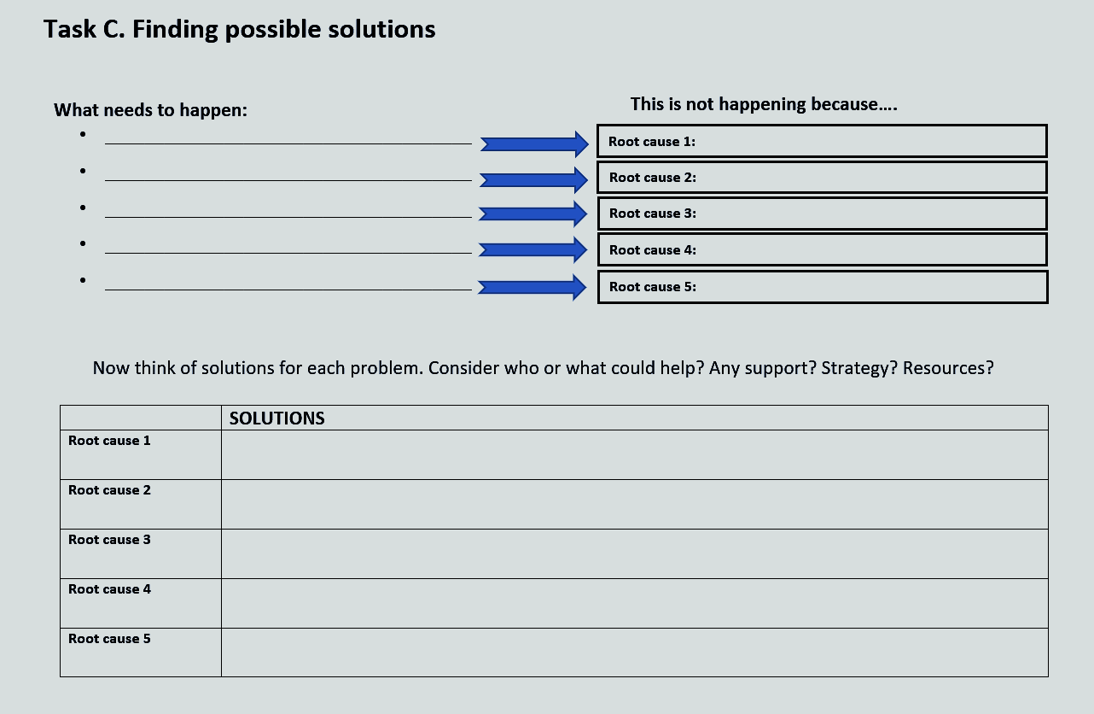
PART 5: Planning for the future
Considering what you have previously found and drafted in your handout :
Is there anything you would like to amend?
Are there points you would like to add or delete?
Discuss

Slide 54




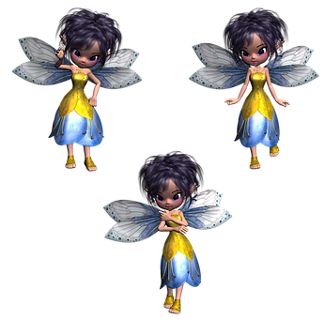







Spontaneous speech: what is your vision?
Describe in a few words the current situation and the overall desired outcome:
Impact on children?
Your team?
The school?
The community?
Vision statement:
What could happen in an ideal world?

Slide 55
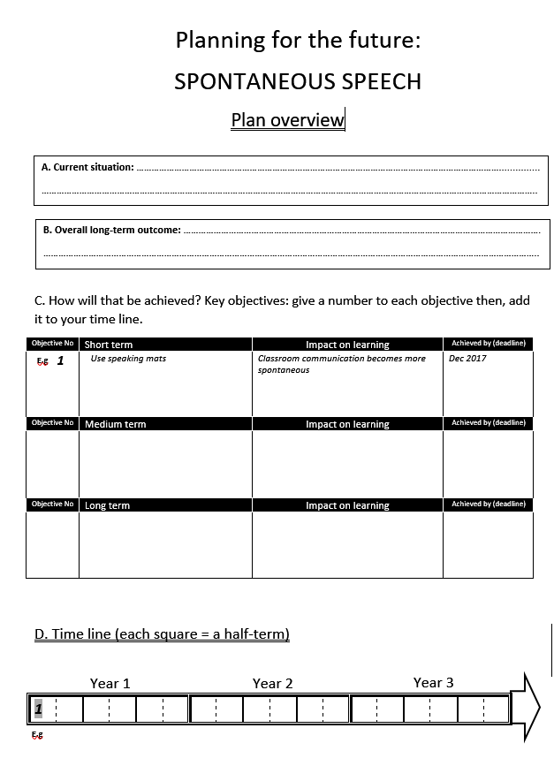
These are likely to be your objectives
Questions you should ask yourself:
Are my objectives short term, medium term or long term?
How will I integrate progression to my planning to achieve my long-term outcome?
What if I have too many objectives to achieve at the same time on my time line?

Slide 56
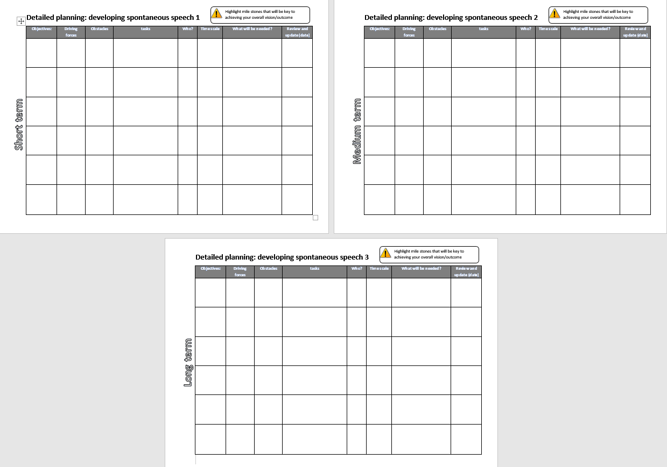
Once your plan overview is complete you can focus on objectives more specifically.

Slide 57
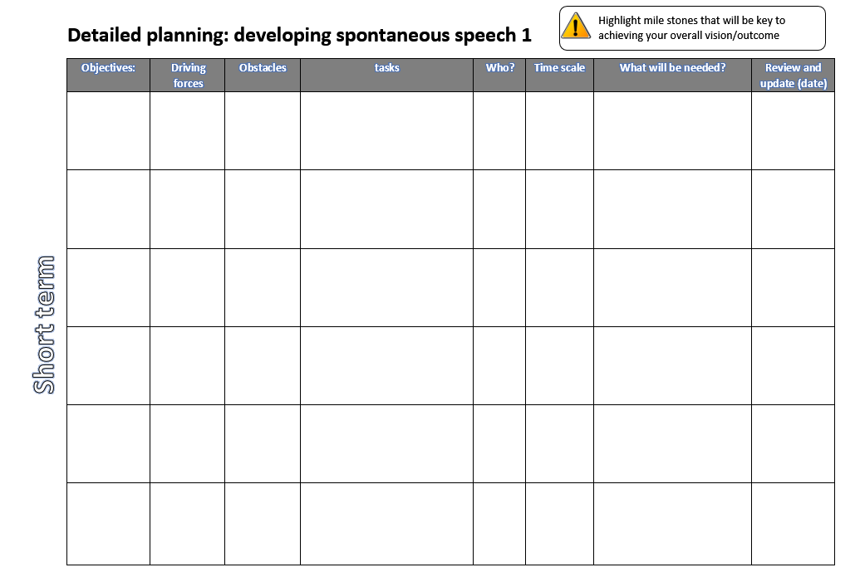
Implement the use of speaking mats
Enthusiastic / innovative
team
Some pupils may be reluctant
Design or purchase the cards
Team discussion
X ?
Whole Team
By Dec 4th
Funding : £?
Team meeting scheduled on
Dec 18th
Review reward system?
Remember that you have already identified the barriers to spontaneous speech and worked out some solutions. Bear those in mind when drafting your detailed plan.

Slide 58


Finally:
Planning for the sake of planning will not lead to successful long-term outcomes. Paper exercises just don’t. It’s best to have fewer objectives strategically thought through than a myriad of unachievable targets.
Objectives are not set in stone; they need to be reassessed in light of the progress made (or not made) towards your overall goal. You may have to review, change, add, delete, tweak etc. A good plan is a plan with plenty of amendments scribbled over it!
Planning collaboratively is often more productive. If you are planning strategies for yourself, sharing your views and ideas is very powerful. Team planning when shared, empowers team members and gives them ownership that usually translates in more effective team focus. (Use your team meetings as a platform for planning?)

Slide 59
Aims of the course:
About oral communication
Research and principles
Developing spontaneous speech
To explore the obstacles to spontaneity and develop some solutions
To get practical ideas that you can use as of tomorrow
To start planning for implementation

Slide 60










Developing spontaneous speech?
سهل
Facile
легко
Einfach
آسان
Fàcil
Jiǎndān

