Slide 1

Using Drama in Languages Lessons
Bringing Language to Life

Slide 2
Introduction
Performing is widely regarded as a powerful tool for language learning—or at least, it should be. Yet, as language educators, we often find that the outcomes of classroom performances in the target language fall short of expectations. In our practice, we tend to focus on a specific language structure or topic, deliberately setting aside the acting component and the skills it demands, along with its potential benefits.

Slide 3
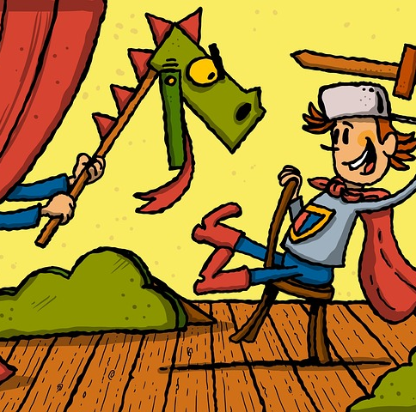
This is what usually happens
Teach a topic/structure.
Get pupils to create a role-play using a prescribed structure or model.
Give very little time for rehearsal (usually a few minutes in the lesson)
Get pupils to perform.
Assess briefly (it doesn’t really count)
Give a round of applause.
Get crossed if someone is messing around while performing.
Feel sorry for those who try very hard but give a lifeless/ boring performance.
Keep smiling in an encouraging way no matter how dire the performance is.

Slide 4

The result:
We often find ourselves frustrated, expecting our pupils to perform like Robert De Niro—just in the target language. What we actually witness are children reciting muddled role-plays that made sense only to them. They dive into the dictionary, eager to express themselves, but the audience is usually left utterly baffled. The result? A bit of a shambles. Most pupils genuinely enjoy performing, just not in the target language. They want it to sound authentic and meaningful, but lack the linguistic tools to deliver a clear, accurate performance that others can follow and enjoy.

Slide 5

Why use plays and sketches?
Pupils want their performance to be accurate. By performing a pre-written script, they do not have to worry about accuracy and can focus on their acting and their delivery in the target language. Participating in plays requires active communication. Learners need to listen, respond, and engage in conversations, helping to improve both verbal and non-verbal communication skills.
Before getting pupils to perform it is important to use the play/sketch as an opportunity to access and understand language out of a specific context. Pupils need to understand the situations, the plot and the effects contained in the script to be able to perform convincingly. Plays and sketches can, therefore, be used as reading activities in line with the MFL Framework (“being sensitive to the written word”)
All pupils have the same script; the audience (the other pupils) should not have any problems with comprehension.
Pupils are encouraged to memorise longer responses; by doing so they develop retention and recall strategies. They also gain in confidence by being able to express themselves accurately. Associating language with actions, emotions, and situations in a play enhances memory retention. Learners are more likely to remember vocabulary and phrases when they are linked to specific experiences in a dramatic context.

Slide 6
Why use plays and sketches?
5) The evaluation doesn't revolve around generating language (since everyone follows the same script), but rather centres on its presentation—accent, intonation, and flow. Amidst the GCSE speaking exam frenzy, the focus often fixates on content, overshadowing crucial elements like accent, delivery, and flow, which are integral components of the grading criteria.
6) Drama provides a real-life context for language use. When learners are engaged in a dramatic scene or play, they are using language in a meaningful and contextual way, which aids in better understanding and retention.
7) Drama often involves exploring different cultural contexts. This exposure helps learners not only understand the language but also the cultural nuances, idioms, and expressions, making their language use more authentic.

Slide 7

Points to consider:
Planning:
The preparatory work and the delivery of the performance require some time. Tailor the approach to suit your preferences and the needs of your students. Consider the option of unfolding it gradually across multiple weeks, with groups showcasing their talents at regular intervals based on a set schedule. Alternatively, you might opt for an immersive experience, dedicating a block of lessons culminating in a grand finale. The choice is yours; just ensure it aligns with your vision and resonates with your pupils.

Slide 8

Points to consider:
Feedback and assessment
The performance serves as a valuable assessment opportunity. Whether you opt for assigning grades or values to individual students, it's crucial to thoroughly evaluate their performance. Additionally, integrating peer assessment can be a fantastic method to underscore and clarify the language criteria for all pupils

Slide 9

Points to consider:
Celebrate success:
Besides applauding their efforts and providing verbal recognition for their hard work, students could receive an achievement certificate, postcard to their parents, etc. You could also compile videos or pictures from the performance into a showcase. This can be shared with the school community, parents, and even on social media platforms. It's a great way to document their achievement, but as usual check safeguarding requirements (check for permissions and school policies first).

Slide 10

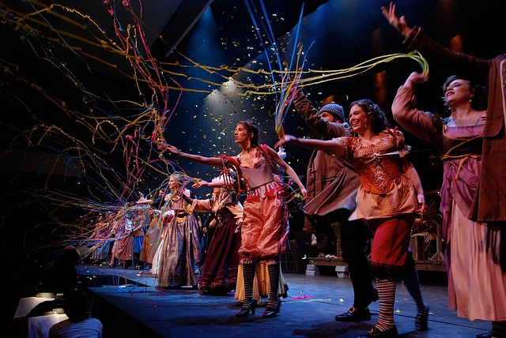
Points to consider:
Further opportunities:
Lastly, discuss future language-related opportunities. This could involve participating in language competitions, joining language clubs, or even planning more language-focused events, like for example, if you and your students are up for it, a longer play performed for the whole school and parents?

Slide 11
Interesting Reads:
Drama Techniques in Foreign Language Teaching by Olga Lucia Zuluaga Valencia
A comprehensive book that explores various drama techniques and their application in foreign language teaching.
The Use of Drama in the Language Classroom by T. McCargar
An article discussing the benefits of using drama in language learning and providing practical examples.
Teaching English Through Drama by Matt Bromley
While focused on English, this book offers insights into using drama as a tool for language teaching that can be adapted for other languages.
If you're interested in exploring how drama can enhance language learning in the classroom, take a look at the following…

